Slide 1
Internet of Things
NC 812/ESD 812
Prof. Jyotsna Bapat/Prof. Debabrata Das

Slide 2
Introduction
Wikipedia Definition
The Internet of Things (IoT) is the interconnection of uniquely identifiable embedded computing devices within the existing Internet infrastructure.
Typically, IoT is expected to offer advanced connectivity of devices, systems, and services that goes beyond machine-to-machine communications (M2M) and covers a variety of protocols, domains, and applications. The interconnection of these embedded devices (including smart objects), is expected to usher in automation in nearly all fields.

Slide 3
Multiple Definitions
Definitions
The Internet of Things, also called The Internet of Objects, refers to a network between objects, usually the network will be wireless and self-configuring, such as household appliances.
By embedding short-range mobile transceivers into a wide array of additional gadgets and everyday items, enabling new forms of communication between people and things, and between things themselves.

Slide 4
What is the Internet of Things?
The term "Internet of Things" has come to describe a number of technologies and research disciplines that enable the Internet to reach out into the real world of physical objects.
The semantic origin of the expression is composed by two words : “Internet” and “Thing”, where “Internet” can be defined as “The world-wide network of interconnected computer networks, based on a standard communication protocol, the Internet suite (TCP/IP)”, while “Thing” is “an object not precisely identifiable” Therefore, semantically, “Internet of Things” means “a world-wide network of interconnected objects uniquely addressable, based on standard.

Slide 5
IoT: Evolution Source: http://www.baselinemag.com/networking/slideshows/a-brief-history-of-the-internet-of-things.html
1969: The Internet Emerges: The first nodes of what would eventually become known as ARPANET, the precursor to today's Internet, are established at UCLA and Stanford universities.
1982: TCP/IP Takes Shape: Internet Protocol (TCP/IP) becomes a standard, ushering in a worldwide network of fully interconnected networks called the Internet.
1990: A Thing Is Born: John Romkey and Simon Hackett create the world's first connected device (other than a computer): a toaster powered through the Internet.

Slide 6
IoT: Evolution
1999: The IoT Gets a Name: Kevin Ashton coins the term "Internet of things" and establishes MIT's Auto-ID Center, a global research network of academic laboratories focused on RFID and the IoT.
1999: Creating an M2M Protocol: Andy Stanford-Clark of IBM and Arlen Nipper of Arcom (now Eurotech) introduce the first machine-to-machine protocol for connected devices: MQ Telemetry Transport (MQTT).
2000: Introducing a Big Chill: LG announces plans for the first connected refrigerator. The fridge will sense items stored inside it using barcode and RFID scanning.
2005: Getting Global Attention: The United Nations first mentions IoT in an International Telecommunications Union report. Three years later, the first international IoT conference takes place in Zurich.

Slide 7
IoT: Evolution
2010: Cars Shift Into High Gear: Google introduces a self-driving vehicle project, a major milestone in the development of a connected and autonomous car.
2010: Bluetooth Gets Smart: Bluetooth Low Energy (BLE) is introduced, enabling applications in the fitness, health care, security, and home entertainment industries.
2011: Making a Nest: Nest Labs (Now Google) introduces sensor-driven, WiFi-enabled, self-learning, programmable thermostats and smoke detectors.
2011: IPV6 Launches: The protocol expands the number of objects that can connect to the Internet by introducing 340 undecillion (10³⁶) IP addresses

Slide 8
IoT: Evolution
2013: Google Raises the Glass: Google Glass, controlled through voice recognition software and a touchpad built into the device, is released to developers.
2014: Apple Takes a Bite: Apple announces HealthKit and HomeKit, two health and home automation developments. The firm's iBeacon advances context and geolocation services. Samsung bought Smart Things in 2014 (home automation).
Explosion of wearable devices: Fitbit, Smart Watches, Home security systems etc.

Slide 9
The Hype
According to some surveys, there will be nearly 26 billion devices on the Internet of Things by 2020. ABI Research estimates that more than 30 billion devices will be wirelessly connected to the Internet of Things (Internet of Everything) by 2020.
As per a recent survey and study done by Pew Research Internet Project, a large majority of the technology experts and engaged Internet users who responded—83 percent—agreed with the notion that the Internet/Cloud of Things, embedded and wearable computing (and the corresponding dynamic systems) will have widespread and beneficial effects by 2025. It is, as such, clear that the IoT will consist of a very large number of devices being connected to the Internet.

Slide 10
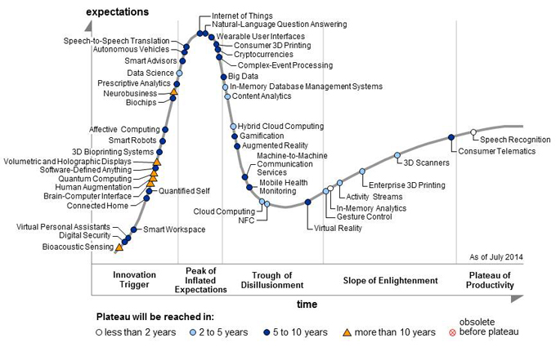
IoT: Hype

Slide 11
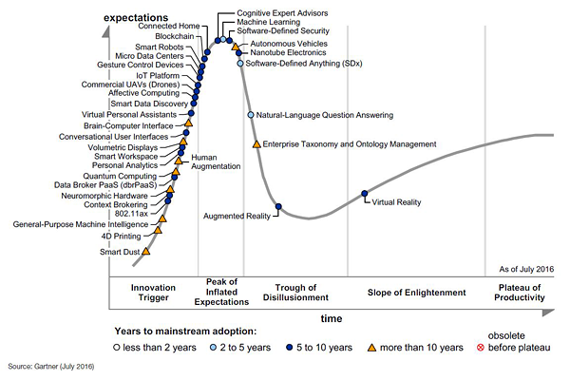
Gartner’s Hype Cycle for Emerging Technologies, 2016

Slide 12
Hype to Reality
The Need for a Common Standard: For IoT to fly, there is a need for a common platform that allows all things to talk to each other and cloud.
While several companies have jumped on the IoT bandwagon by creating specialized hardware, many of these devices can’t talk to one another, as each is built using different rules and protocols.
Currently, sensors use existing connectivity standards such as WiFi, Bluetooth and NFC, but these may not be able to handle the volume of data generated.

Slide 13
Hype to Reality
Performance Issues: IoT requires any-time, anywhere connectivity (read cloud computing) at high speed, supplemented by Big Data tools to churn out data analysis results in nano-seconds to deliver real-time impact.
This underlines the need to implement ubiquitous and reliable connectivity, which does not affect the resources (battery efficiency) of the devices interacting with it.
Security: With the proliferation of open standards and inter-device communication, the ‘hackable’ points in a network increase manifold.

Slide 14
Reality: IPV6
Integration with the Internet implies that devices will utilize an IP address as a unique identifier. However, due to the limited address space of IPv4 (which allows for 4.3 billion unique addresses), objects in the IoT will have to use IPv6 to accommodate the extremely large address space required.
Objects in the IoT will not only be devices with sensory capabilities, but also provide actuation capabilities (e.g., bulbs or locks controlled over the Internet). To a large extent, the future of the Internet of Things will not be possible without the support of IPv6; and consequently the global adoption of IPv6 in the coming years will be critical for the successful development of the IoT in the future.

Slide 15
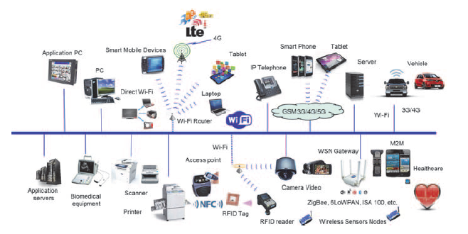
IP Convergence

Slide 16
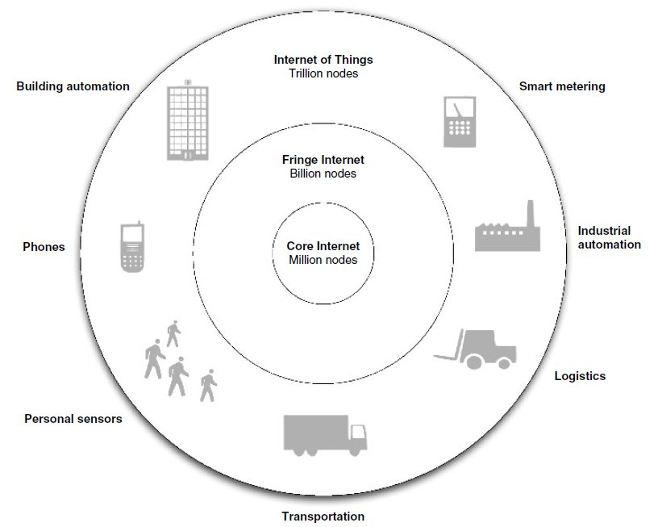
IoT Vision (source: 6LoWPAN: The wireless embedded Internet, EE Times)

Slide 17
IoT Vision
Internet is made up of a core Internet of backbone routers and servers, including millions of nodes in total. The core Internet has extremely high capacity.
Majority of today's Internet nodes are in what is sometimes called the fringe Internet. Those include all the personal computers, laptops and local network infrastructure connected to the Internet. This fringe changes rapidly, and is estimated to have up to a billion nodes.

Slide 18
IoT Vision
Internet of Things is made up of the IP-enabled embedded devices connected to the Internet, including sensors, machines, active positioning tags, radio-frequency identification (RFID) readers and building automation equipment to name but a few.
The exact size of the Internet of Things is hard to estimate, as its growth is not dependent on human users. It is assumed that the Internet of Things will soon exceed the rest of the Internet in size (number of nodes) and will continue growing at a rapid rate.

Slide 19
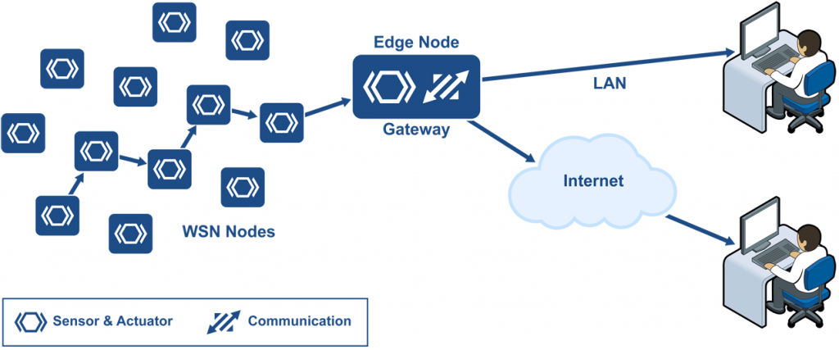
Communication

Slide 20
Smart environment: Dimensions
Privacy
Security
Decision Making, Rule Engine
Information from the Data
Prediction, Data Mining etc.
Communication: Local and to the cloud
WSN
Hardware: Sensors and Actuators

Slide 21
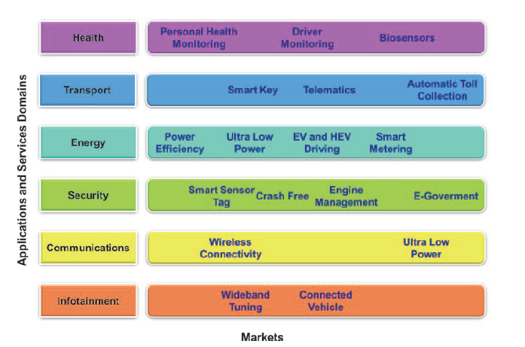
Applications

Slide 22
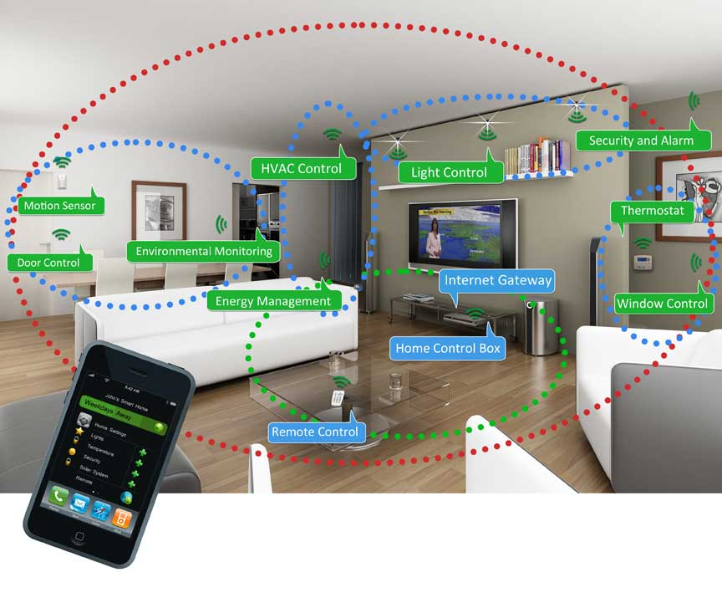
Smart Home

Slide 23
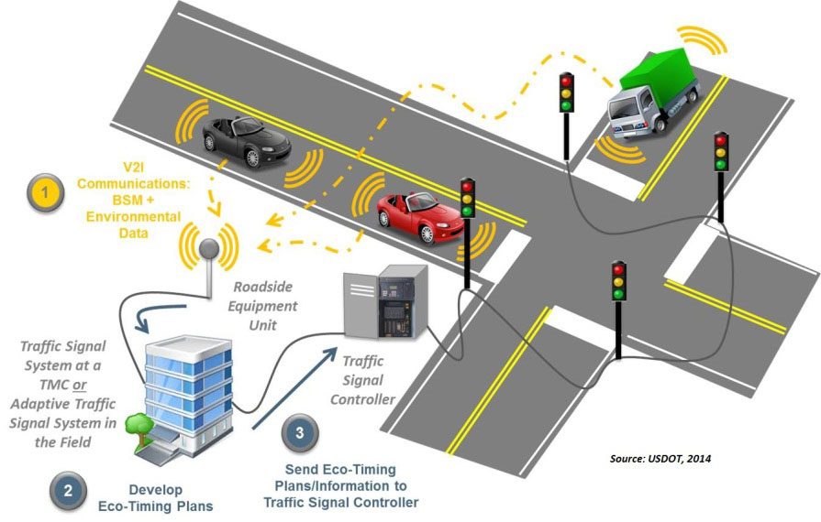
Intelligent Traffic Systems

Slide 24
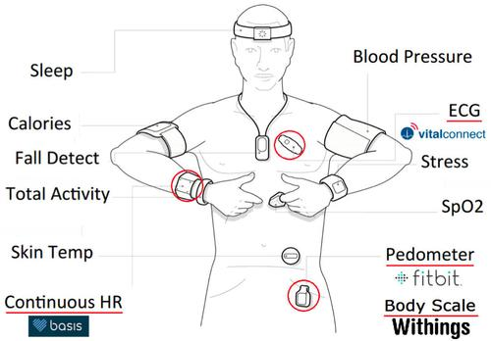
Health: Wearable Devices

Slide 25
Enabling Technologies
Enabling technologies for the Internet of Things such as sensor networks, RFID, M2M, mobile Internet, semantic data integration, semantic search, IPv6, etc. can be grouped into three categories:
Technologies that enable “things” to acquire contextual information,
Technologies that enable “things” to process contextual information, and
Technologies to improve security and privacy.
The first two categories can be jointly understood as functional building blocks required building “intelligence” into “things”, which are the features that differentiate the IoT from the usual Internet.
The third category is not a functional but rather a de facto requirement, without which the penetration of the IoT would be severely reduced.

Slide 26
Enabling Technologies
Internet of Things developments implies that the environments, cities, buildings, vehicles, clothing, portable devices and other objects have more and more information associated with them and/or the ability to sense, communicate, network and produce new information.
In addition we can also include non-sensing things (i.e. things that may have functionality, but do not provide information or data). All the computers connected to the Internet can talk to each other and with the connection of mobile phones it has now become mobile. The Internet evolution based on the level of information and social connectivity.
With the Internet of Things the communication is extended via Internet to all the things that surround us. The Internet of Things is much more than M2M communication, wireless sensor networks, 2G/3G/4G, RFID, etc.
These are considered as being the enabling technologies that make “Internet of Things” applications possible.

Slide 27
IoT: Requirements
Network neutrality is an essential element where no bit of information should be prioritized over another so the principle of connecting anything from/to anybody located anywhere at any-time using the most appropriate physical path from any-path available between the sender and the recipient is applied in practice.
For respecting these principles, Internet service providers and governments need to treat all data on the Internet equally, not discriminating or charging differentially by user, content, site, platform, application, type of attached equipment, and modes of communication.

Slide 28
IoT: Technologies
Ten “critical” trends and technologies impacting IT for the next five years were laid out by Gartner in 2012 and among them the Internet of Things, which will benefit from cheap, small devices allowing that everything will have a radio and location capability.
Self-assembling mesh networks, location aware services will be provided. This all creates the always on society.

Slide 29
Course Flow
IoT is a multidisciplinary topic. Course on the other hand is a linear entity.
Will be covering topics linearly, while in your projects, you must take into account all relevant issues.
Sensors/RFID
Communication Challenges and Proposed techniques
Networking Issues
Data Analysis. Making sense of data exhaust
Privacy, Security issues.
Edge Computing: Cloud vs. Fog

Slide 30
Course Outline
Course Objective:
At the end of the course, the student will be able to understand:
What is Internet of Things (IoT) and why IoT is needed?
Requirements of the IoT Systems: Connectivity, Security, Manageability and Safety
Important building blocks in IoT: Sensors, Communication infrastructure
Challenges in connecting millions of devices to Internet (Spectrum availability and usage)
QoS issues: How do you guarantee service coverage and latency when number of devices are so large (MAC layer)
Privacy Issues
Application Areas

Slide 31
Course Outline
Important elements in IoT: Sensors, Communication infrastructure
Localization, Defining location, Location Systems (e.g. GPS, indoor localization)
Privacy Issues
Application Areas:
Smart City/ Smart Homes
Elderly/Child Health Monitoring
Traffic Control
smart Grid
Precision Agriculture
Safety in large public buildings (Schools, hospitals, malls etc)
The future and open directions of IoT

Slide 32
Grading
Midterm and Final: 40%
Paper Review/Presentation: 10%
Labs: 10%
Project (groups of 3): 40%

Slide 33
Projects
Project Proposals: Due Jan 24th
Revised proposals: Due Feb 7th
Midterm review: End of Feb
Final demo and complete reports: First week of May

